Slide 1
Cars Price Prediction
Submitted by
Tushar Kumar Patel

Slide 2
Project analysis slide 2
Project Analysis
Inrtoduction
Visualization
Car price prediction
Dataset and Features
Model
Processing
Conclusion

Slide 3
Introduction
In this Covid situation cars are one of the necessary need of each and every person around the globe and therefore new car and used car market is also one of the market which has one of the major contributors in the economy also. It is also very large market same as the market for new car and there are various companies working in the domain. Data science comes as a very important tool to solve problems in the domain to help the companies increase their overall revenue, profits, improving their marketing strategies and focusing on changing trends in sales and purchase of the used cars also. Predictive modelling, Market mix modelling, recommendation systems are some of the machine learning techniques used for achieving the business goals for used car companies. Our problem is related to price prediction of the used cars during this covid-19 situation.

Slide 4
CONCEPTUAL BACKGROUND OF THE DOMAIN PROBLEM
With the covid 19 impact in the market, we have seen lot of changes in the car market. Now some cars are in demand hence making them costly and some are not in demand hence cheaper. One of our clients works with small traders, who sell used cars. With the change in market due to covid 19 impact, our client is facing problems with their previous car price valuation machine learning models. So, they are looking for new machine learning models from new data. We have to make car price valuation model.

Slide 5
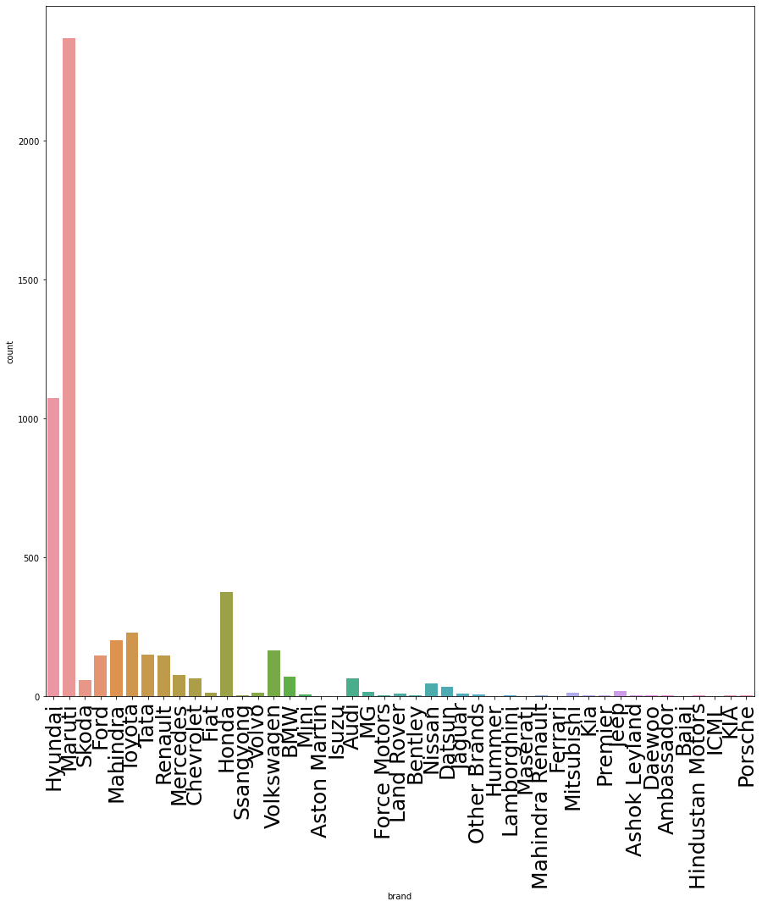
Visualizations
Brands

Slide 6
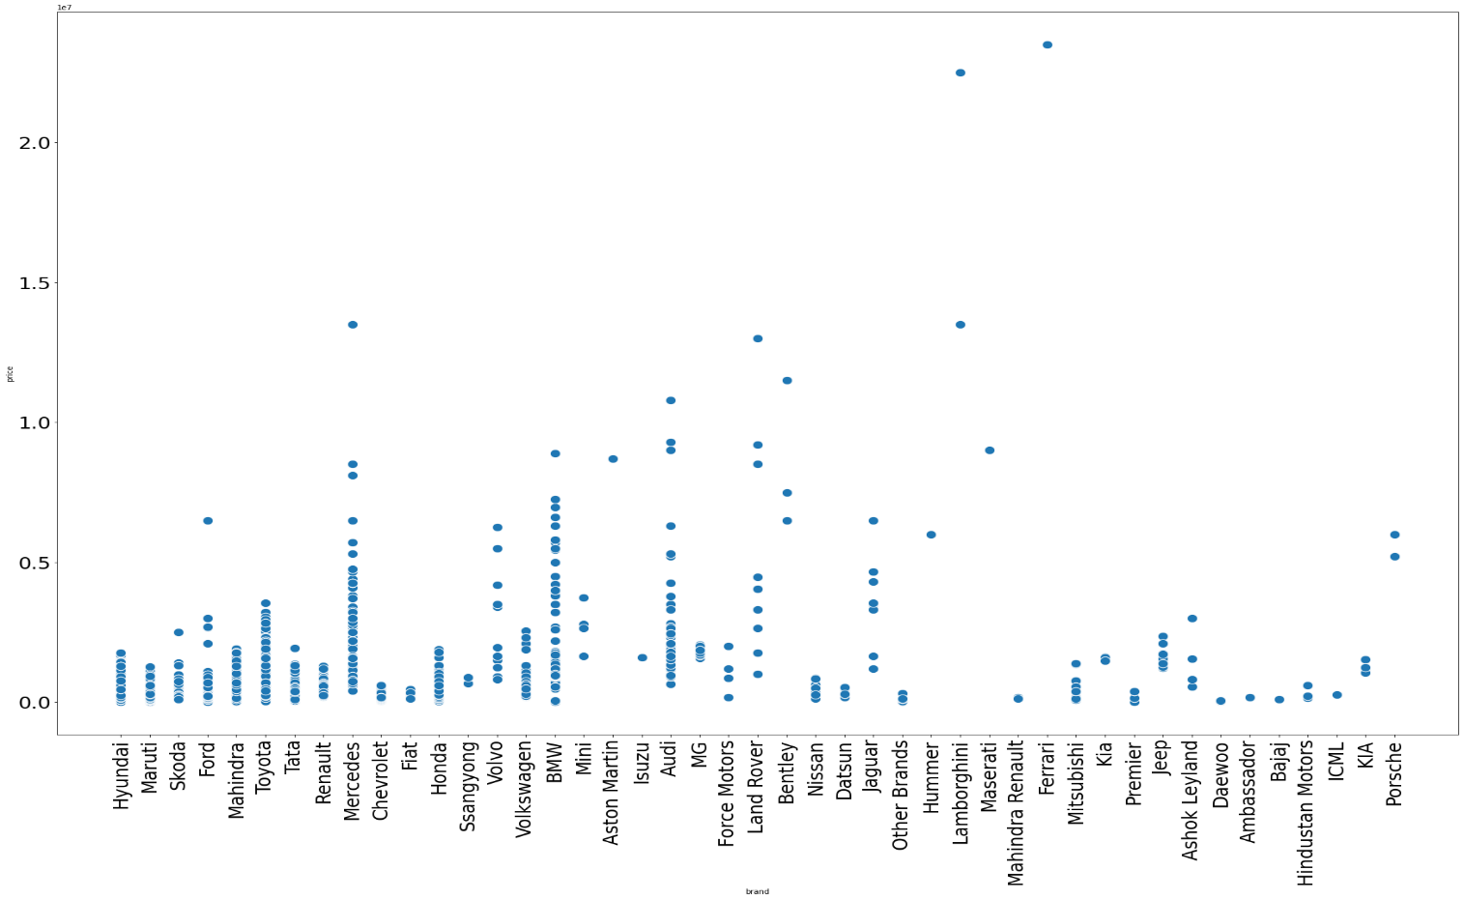
Price

Slide 7
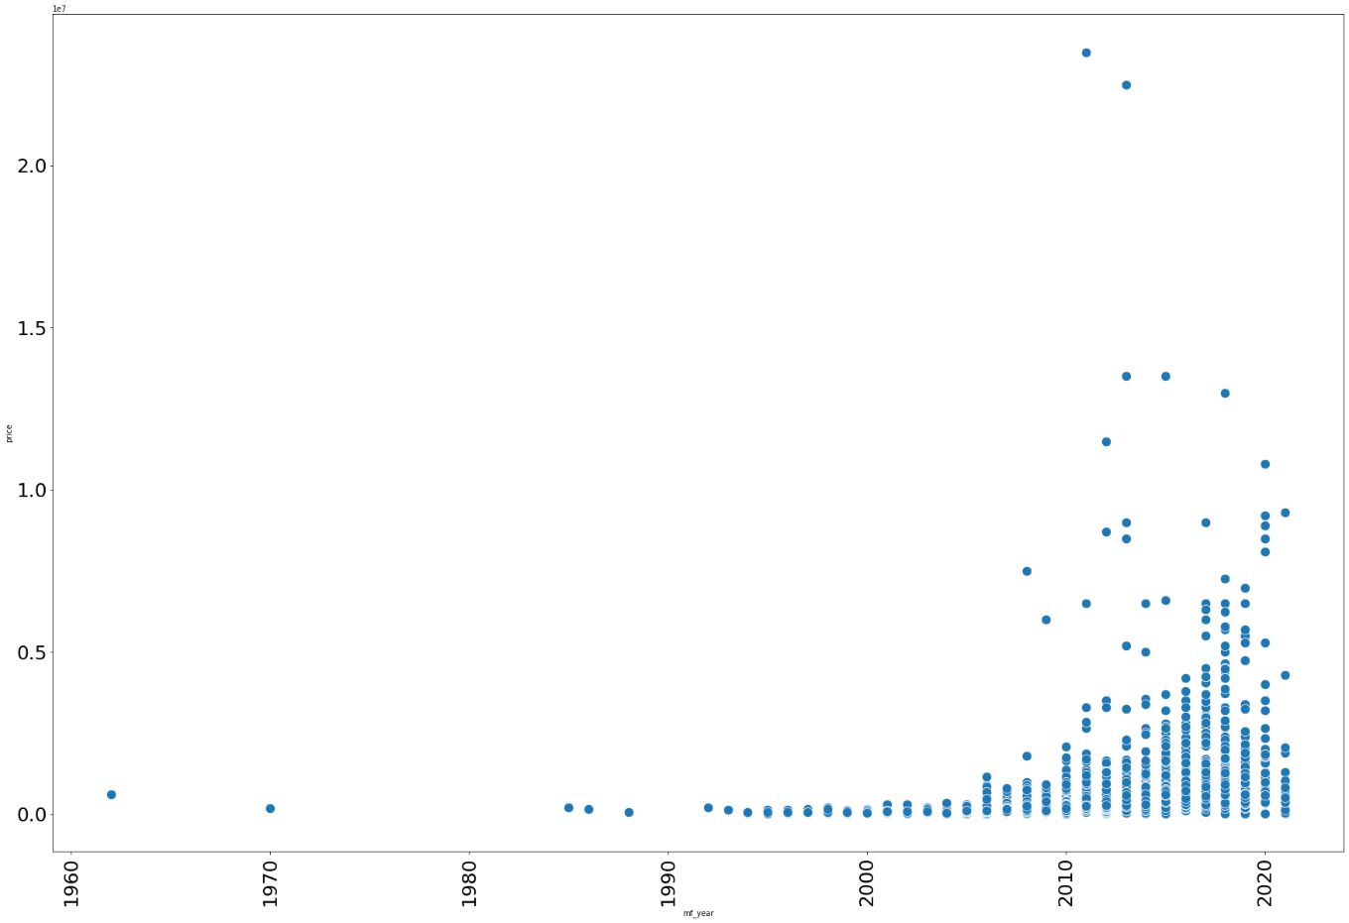
Price year wise

Slide 8
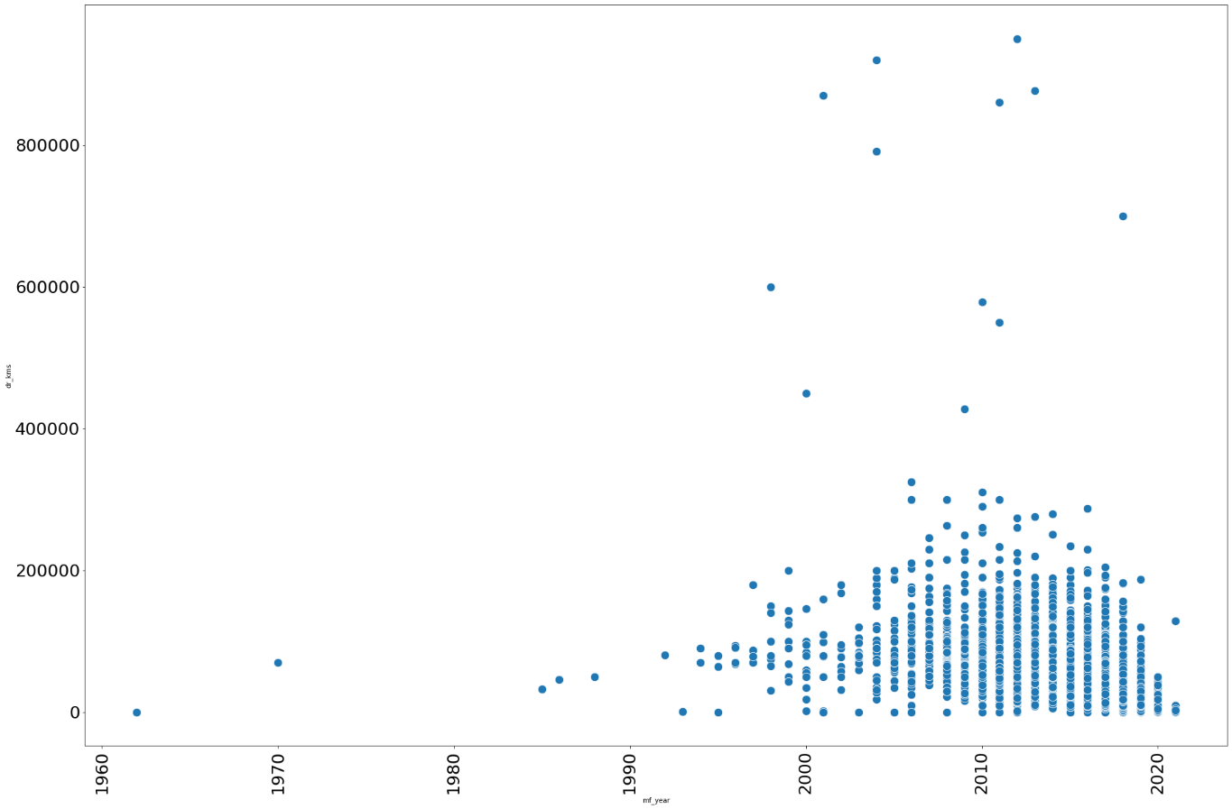
Manufacture year with driven kilometers

Slide 9
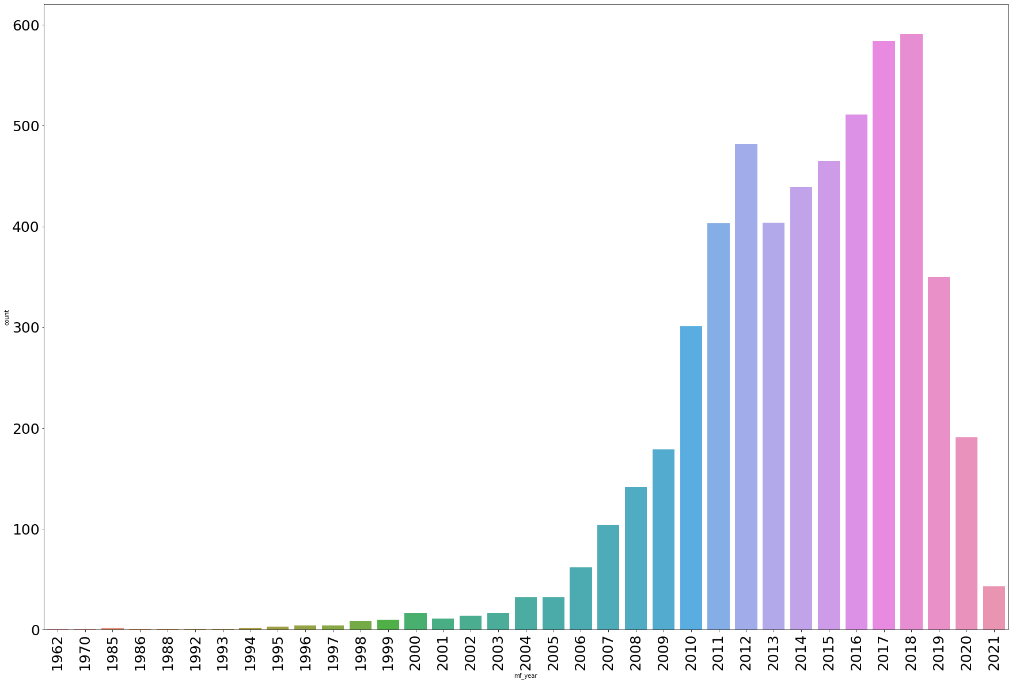
Count with a manufacture year

Slide 10
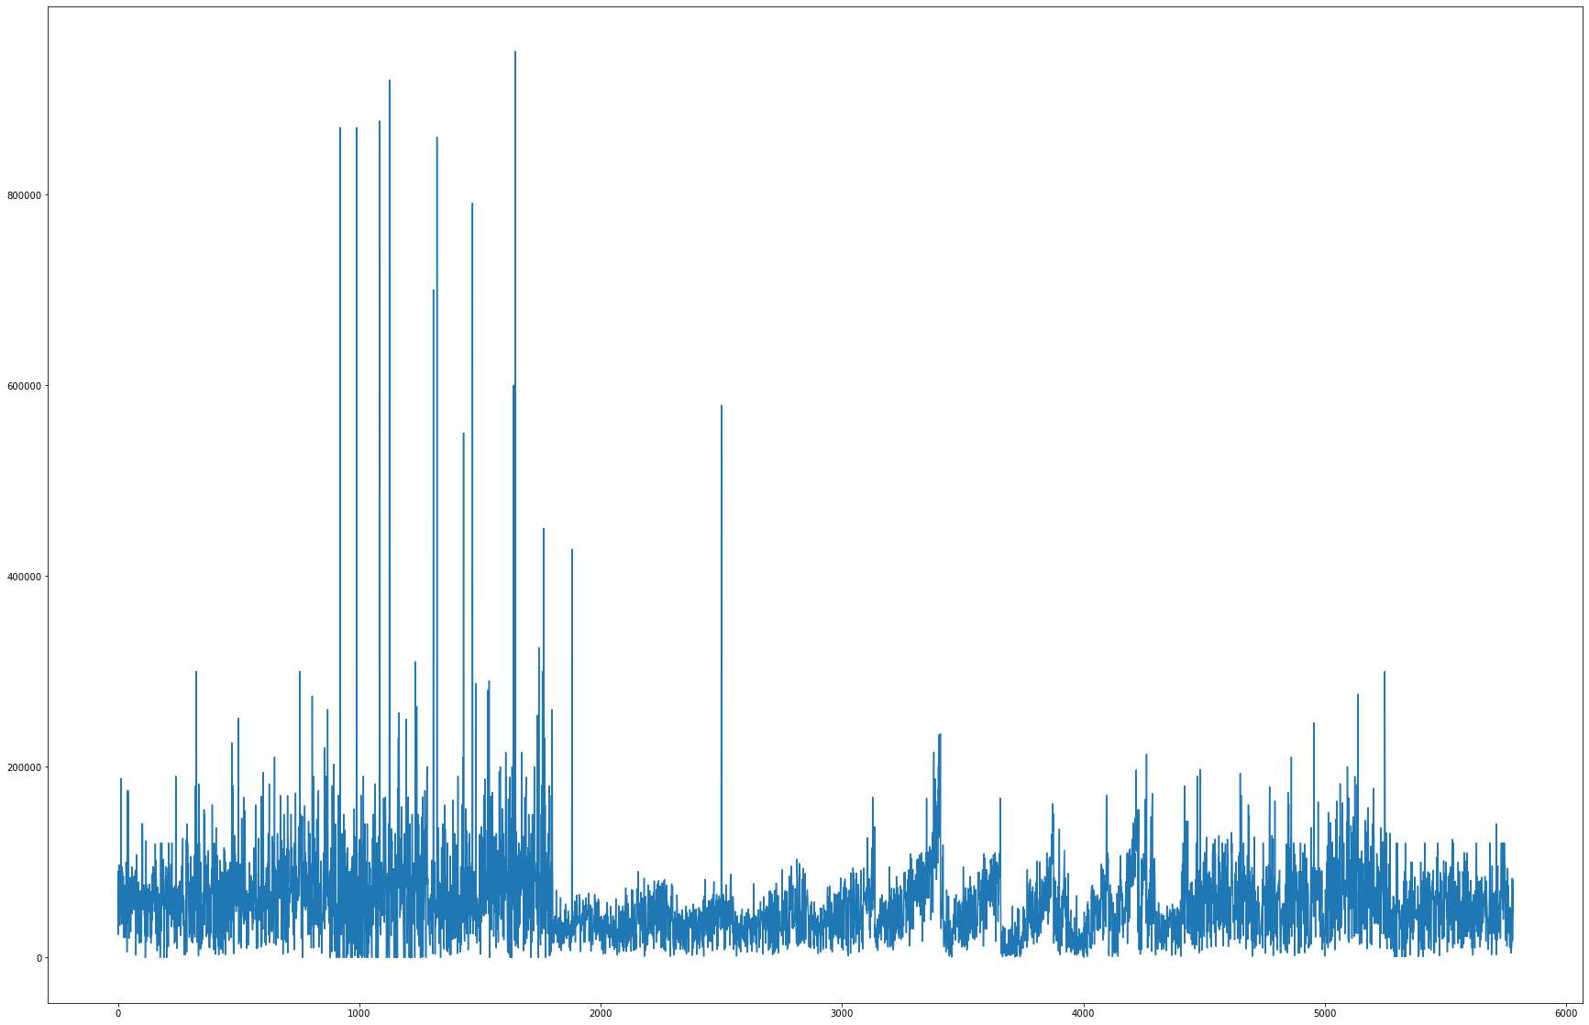
Distplot of the price

Slide 11
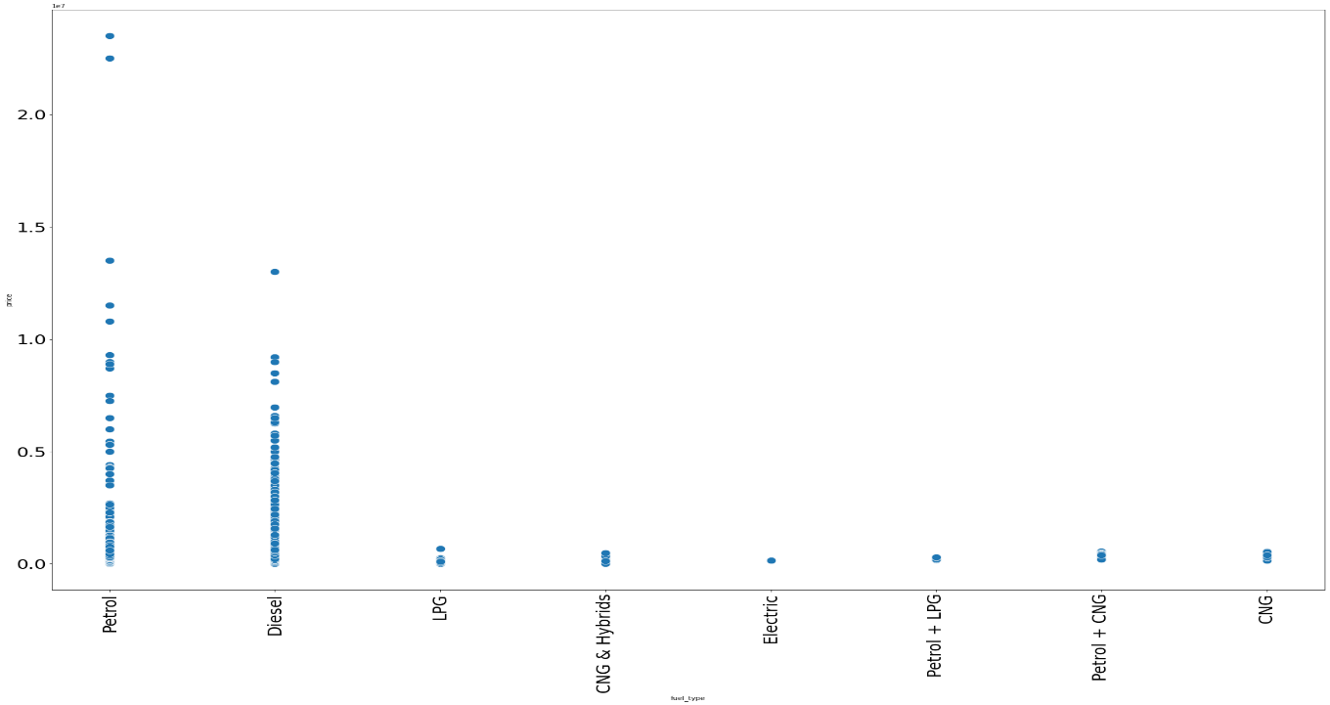
Fuel type with price

Slide 12
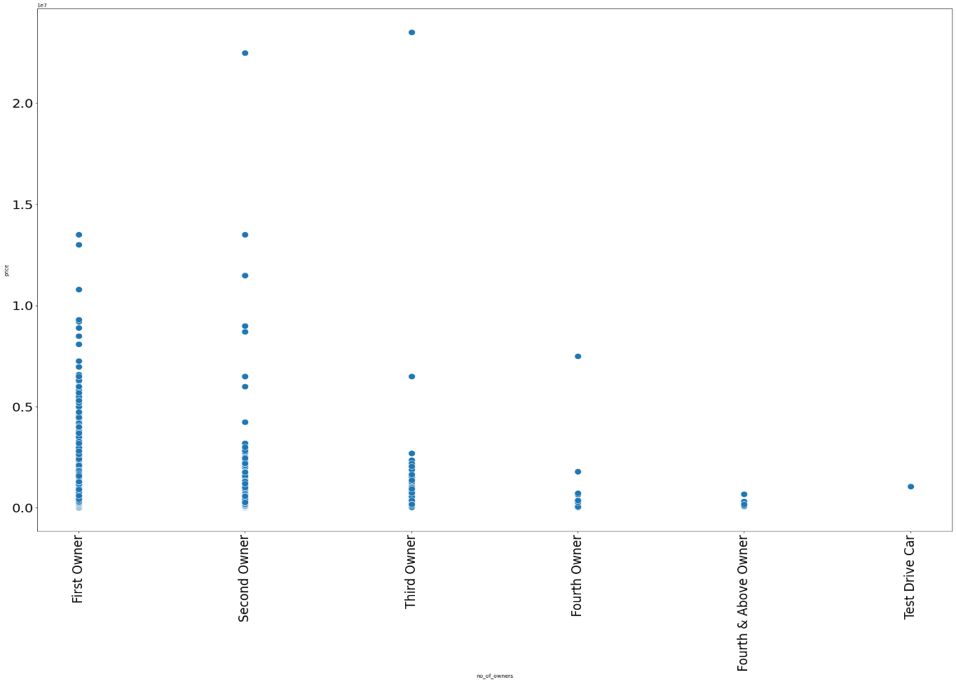
No.of owners with price

Slide 13
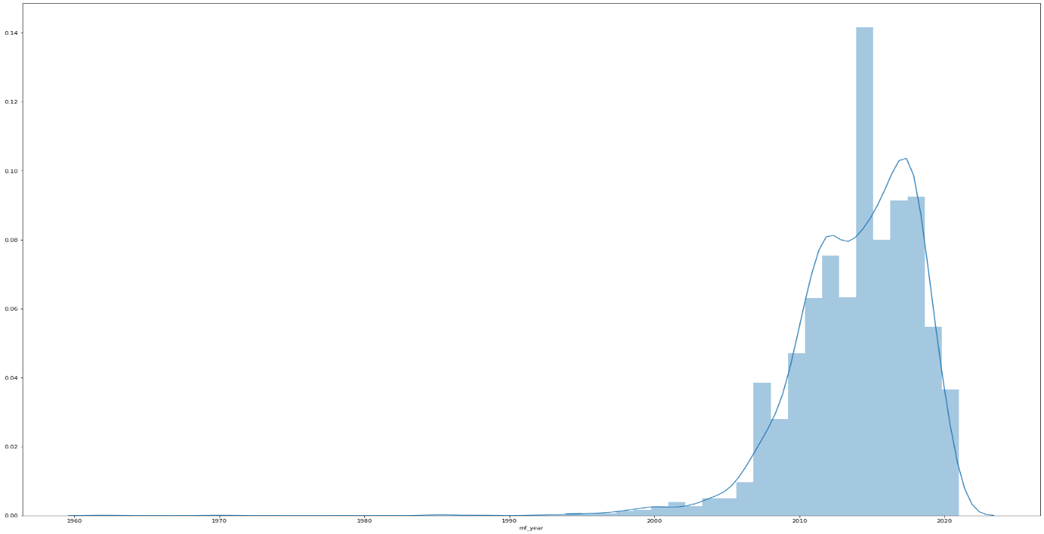
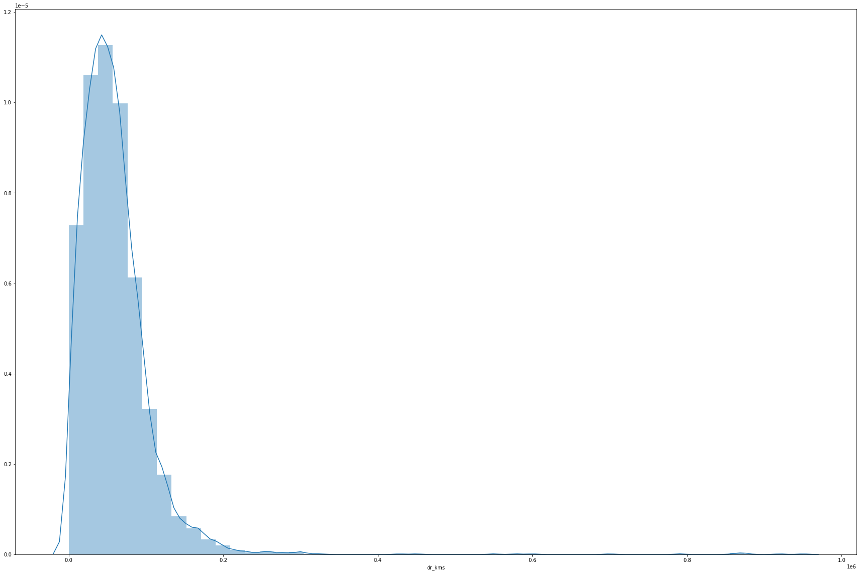
Distplot of mf_year and driven kilometers

Slide 14
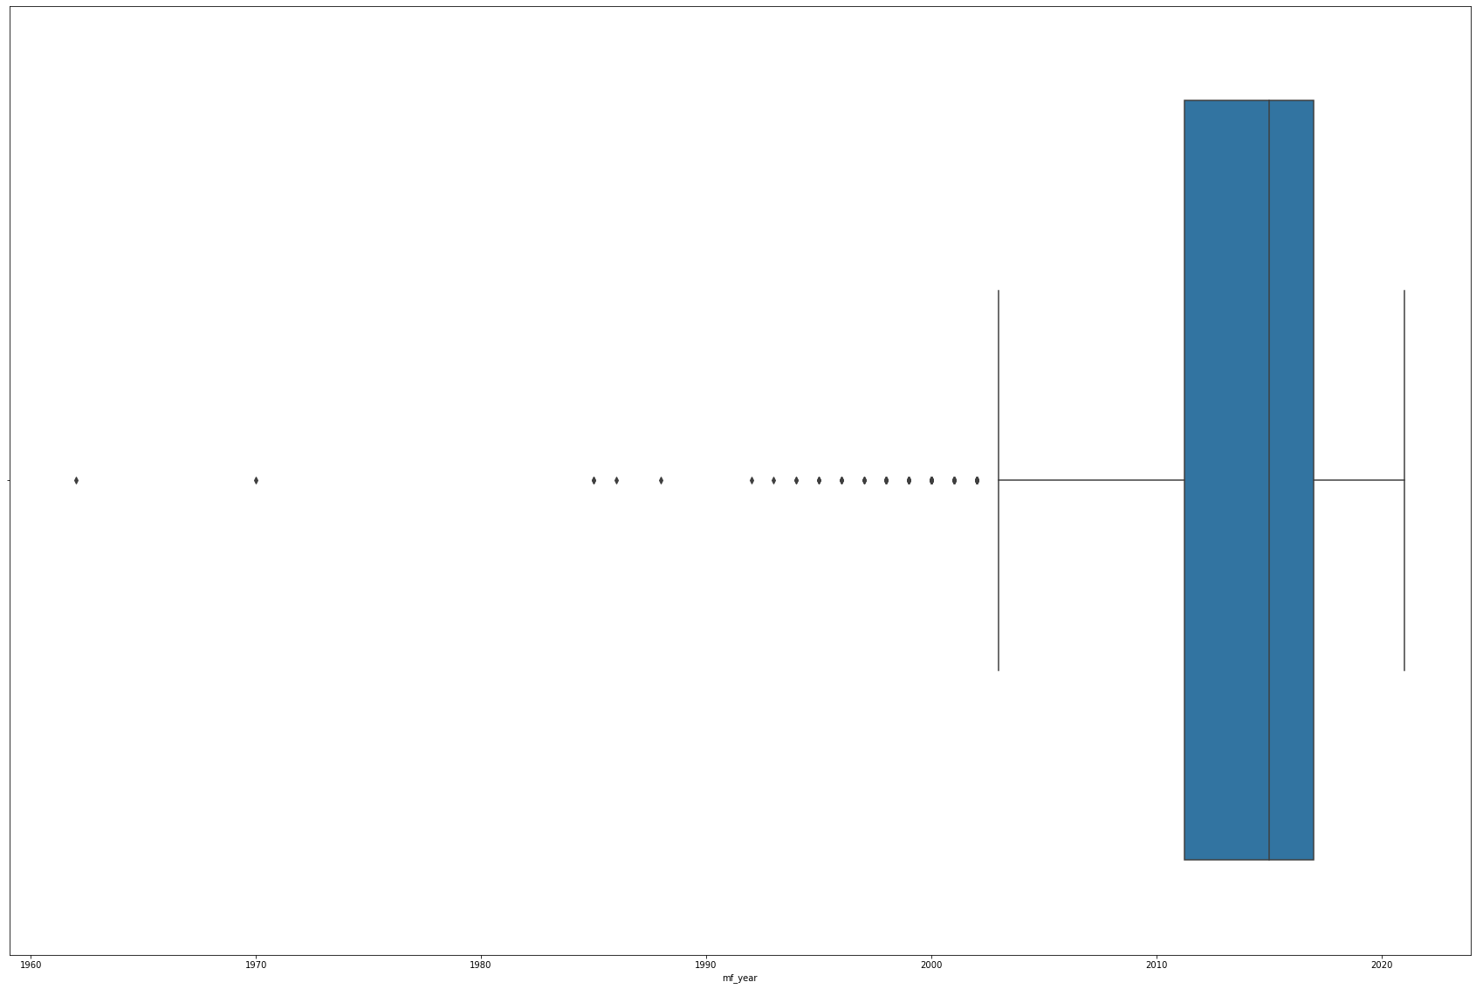
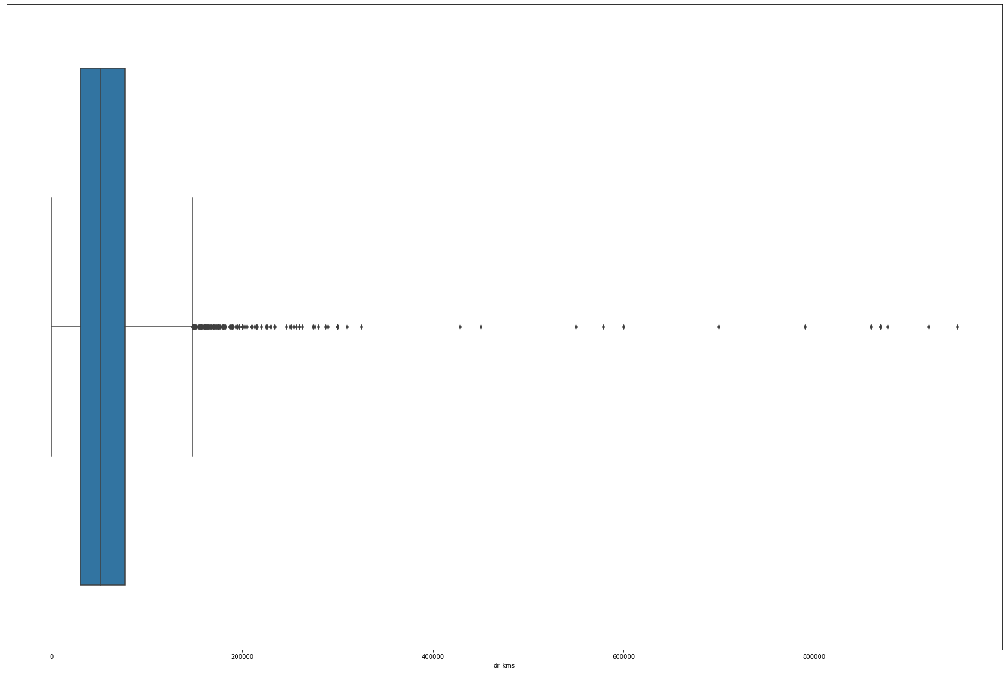
Boxplot of mf_year and driven kilometers

Slide 15
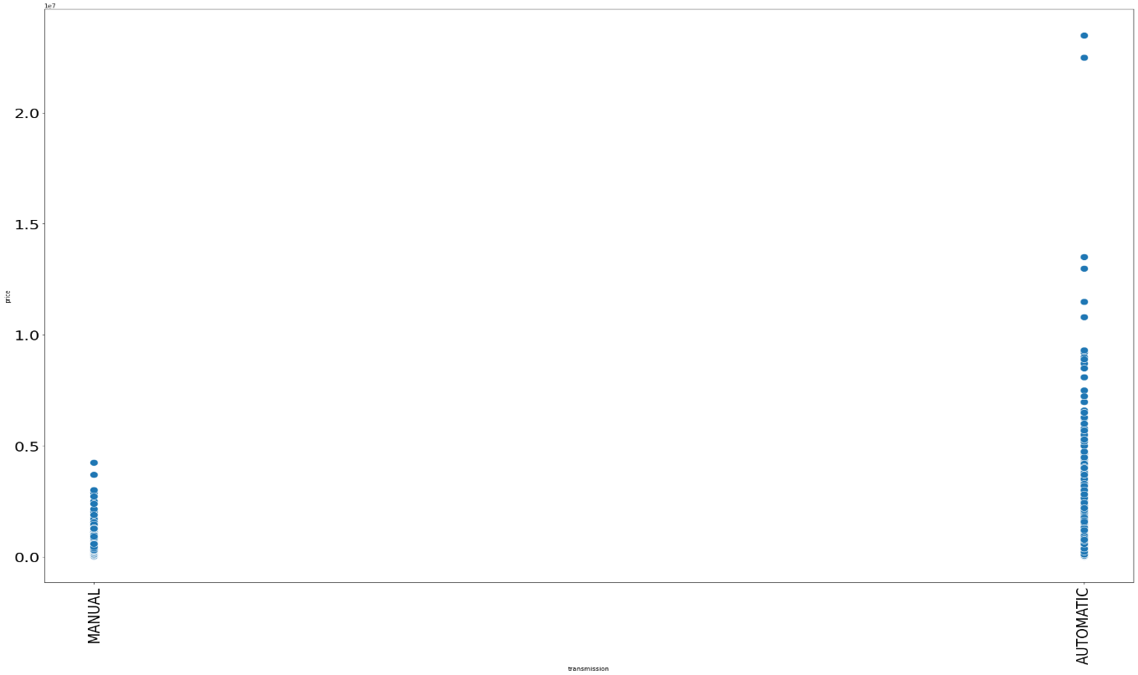
Transmission type with price

Slide 16
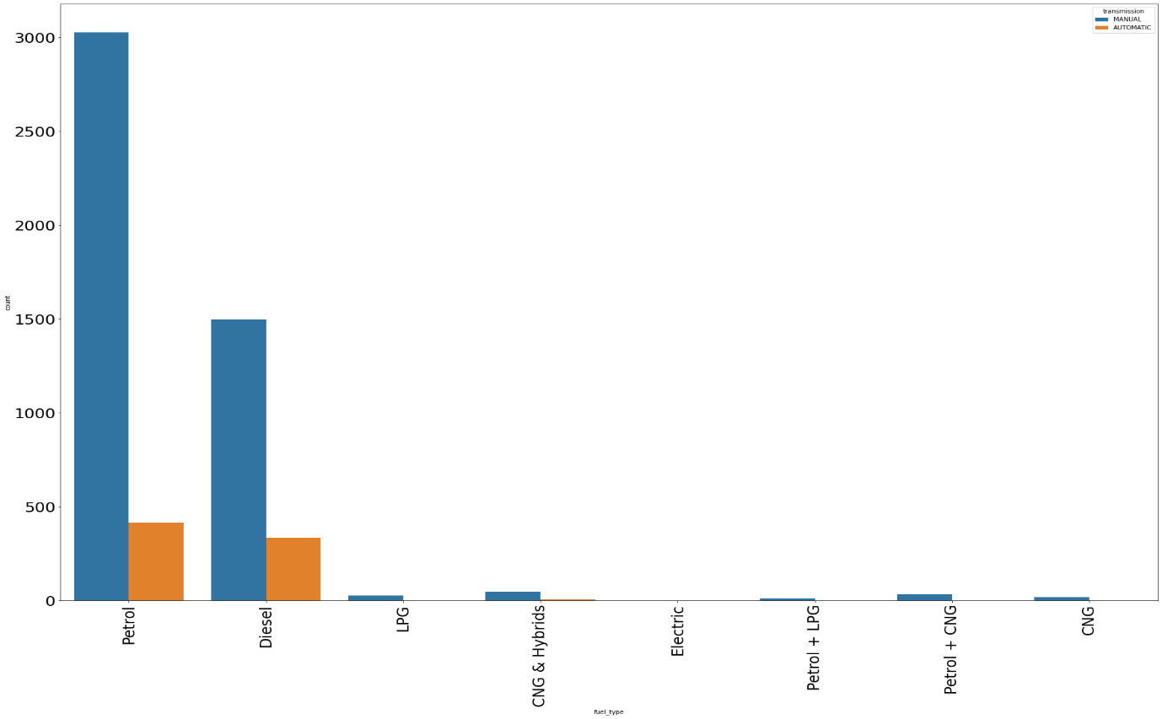
Count of vehicles with different fuel types

Slide 17
Interpretation of the Results
  Most of the vehicles in the used car industry are Maruti and Hyundai
  Premium vehicles are very less
  The most expensive cars are Ferrari and Lamborghini
  Hyundai, Datsun, and Maruti are some of the budget-friendly brands
  lesser the age of the vehicle higher will be the price
  we can see that the purchasing of vehicles started booming around 2010
  from 2018, it has been started to decline

Slide 18
  Most of the vehicles are petrol
  Gas or hybrid vehicles are very less
  No electric vehicles in our dataset
  In used car industry, uncommon fueled vehicles are cheaper(CNG, LPG etc) than petrol and diesel
  Generally, we can say that when no. of owners increases, price decreases
  The prices of the car is not much different from city to city
  Automatic cars are more expensive
  In every fuel type, the manual is higher in number than automatic
driven kilometers and mf_year are highly -ve correlated

Slide 20
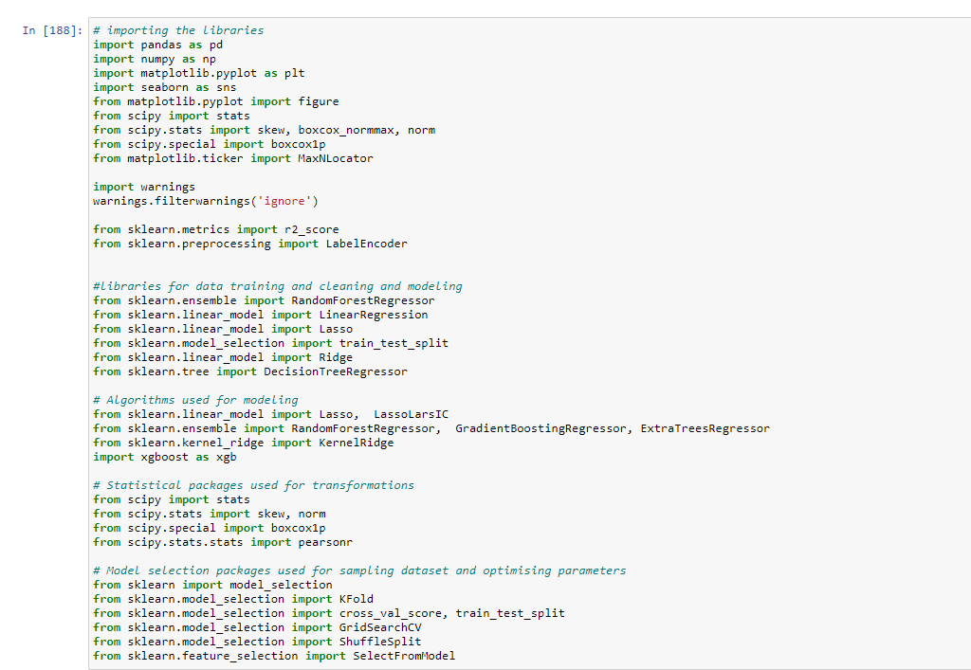

Slide 21
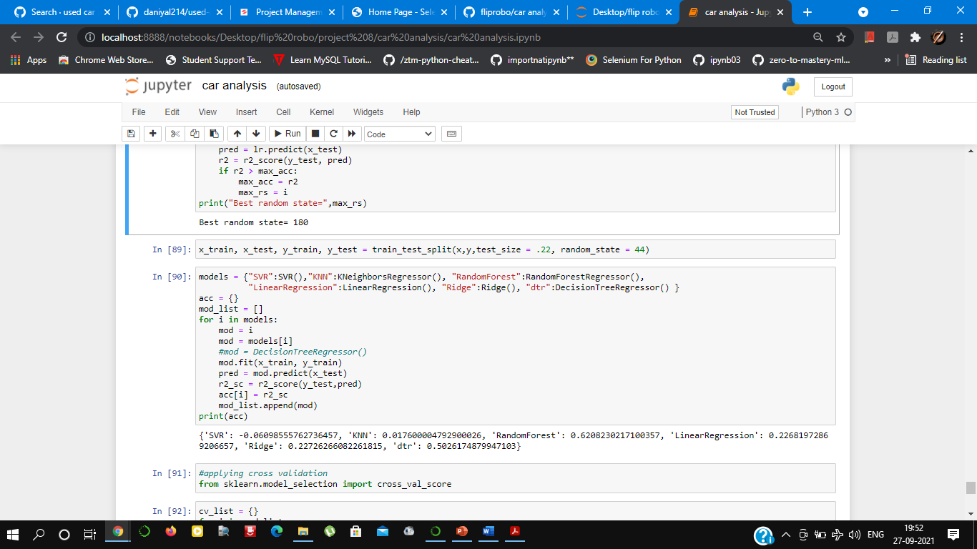
Project analysis slide 3
Model and Their Results
Learning Score: 88.745
Accuracy score: 88.89
Cross val score: 88.78
Roc Auc Curve: 54.44
Log loss : 3.835

Slide 22
Interpretation of the Results
I have used visualization tool such as hist Plot, scatterplot barplot to understand the data in a better way.
I used describe method for five-point summary analysis and also found the number of rows and columns in dataset.
I have done the model building in regression model to improve my accuracy of my prediction.

Slide 23
CONCLUSIONS
I have managed out how to prepare a model that gives users for a novel best approach at future lodging value predictions.
a) I have train datastet from which I had to extract information.
b) I had used pandas library to read the Dataset which provide me to explore & visualize the Data properly based on Rows & Columns.
c) After from all datasets, I preprocessed the data using replacing all zeros & filling counts in this dataset.
d) I did exploratory data analysis on main data frame and tried to see all visualizations.
e) Based on visualization knowledge, I use various EDA TECHNIQUES to plot the Graph.
f) On this data, I have applied our machine learning regression models such as KNN Regressor, Linear regression, Random forest Regressor Model, Decision Tree Regresssor, SVR, and Ridge with the dataset.
i) Based on the model prediction now I predict to analyze.
j) After which I take Random Forest Regressor to predict test data.
k) At the end I make Data Frame to understand the SalePrice of the dataset.
l) Based on the model scores, to predict House Prediction Random Forest Regressor seems to be the best model for this dataset.

Slide 24
Conclusion
Found out the key features that related to the price of a used car and was able to make a machine learning model that predicts the car price.
With the help of exploratory data analysis we could visualize the large data and make interpretation of it and also summary statistics helped us understand how data is spread, where outliers are present to what extend deviation is present and understanding the relationship between target column and other attributes, repeated columns was eliminated to making right prediction.
The accuracy of the ML model is low. We got an accuracy of around 54.7%.

Slide 25
Thank You

